Slide 1


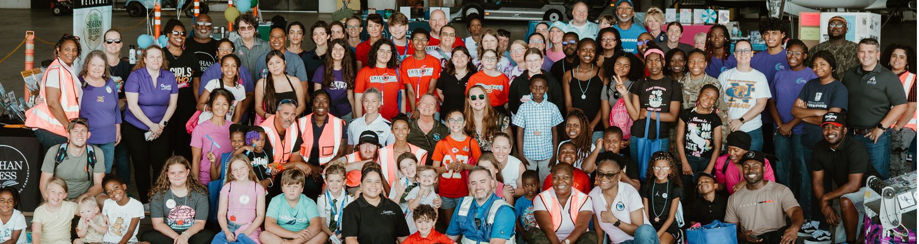
“GIAD” Girls in aviation day
2025

Slide 2
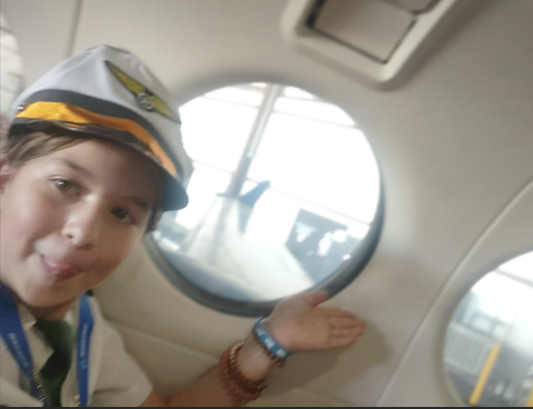

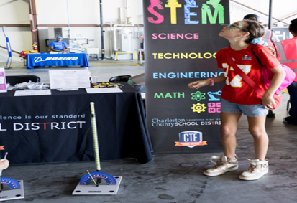

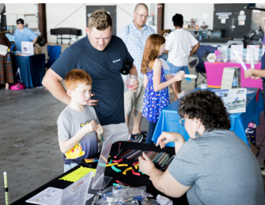
Stem activities:
building robots, electric fans, lava lamps, scavenger hunts, airplanes, and so much more.
Vendors:
Signature Flight, DavisAir, Colleges, robotics, Girl Scouts, GEM club, local schools, Tuskegee, Blue Ridge Chapter of the Ninety-Nines, CHS Flight school, Comcast and Boeing Dreamleaners
Sat Sept 20, 2025
60+ Attendees!
WAI Women in Aviation” Palmetto Pride Chapter of SC “ President : Leslie Lane

Slide 3
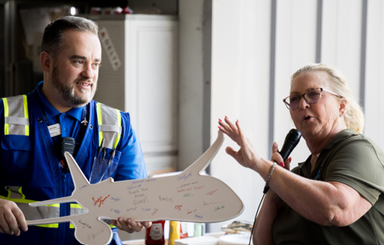
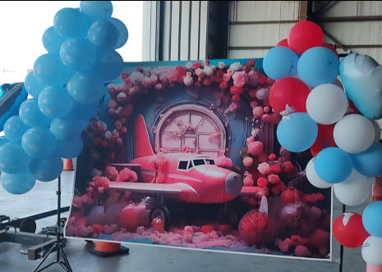
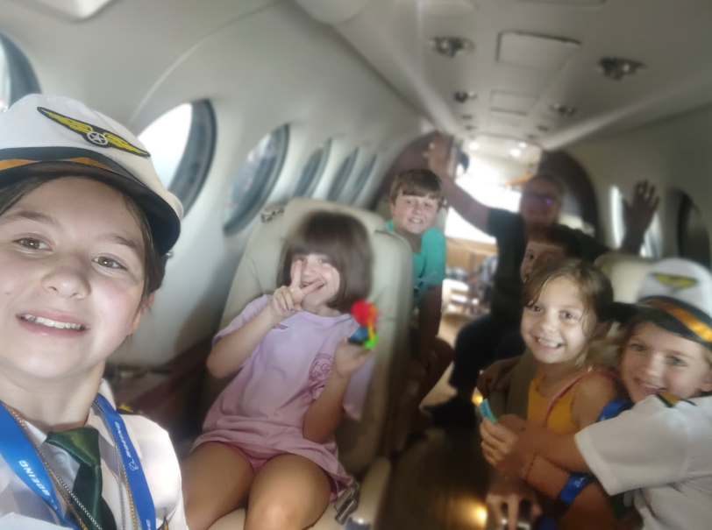
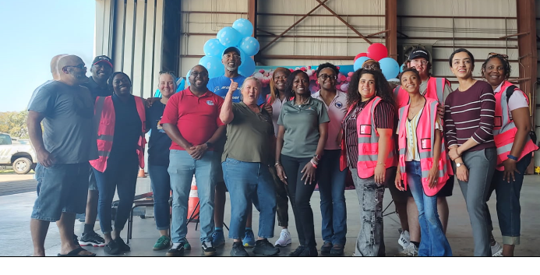
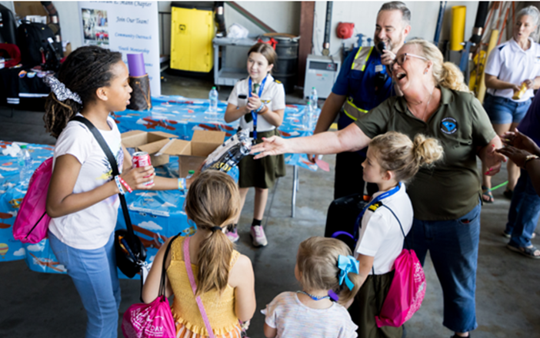
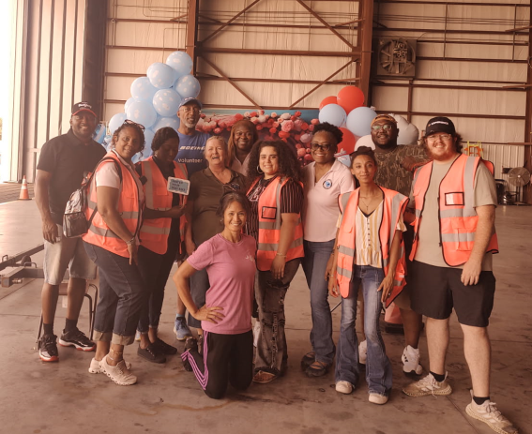
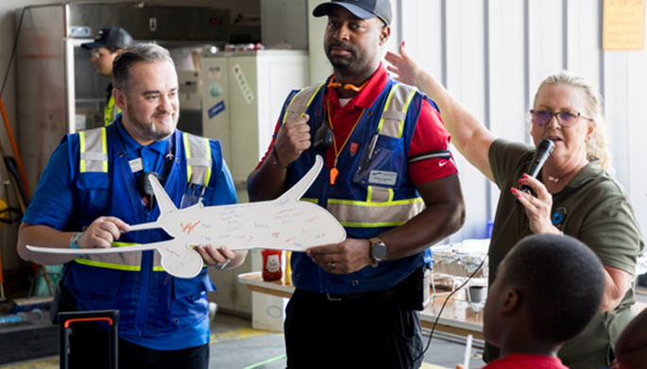

Slide 4
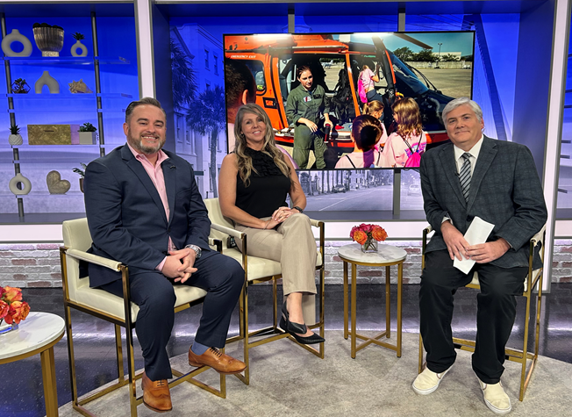
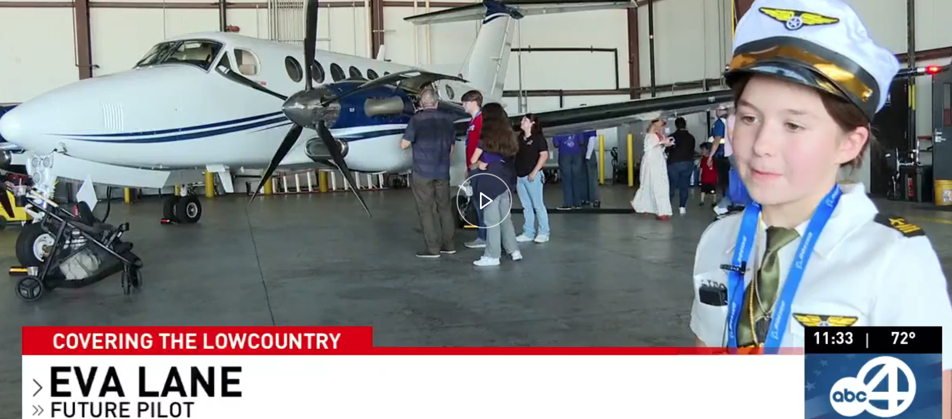

Girls in Aviation Day inspires future pilots in North Charleston
Ava Lane 10 years old

Slide 5
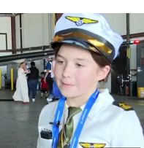
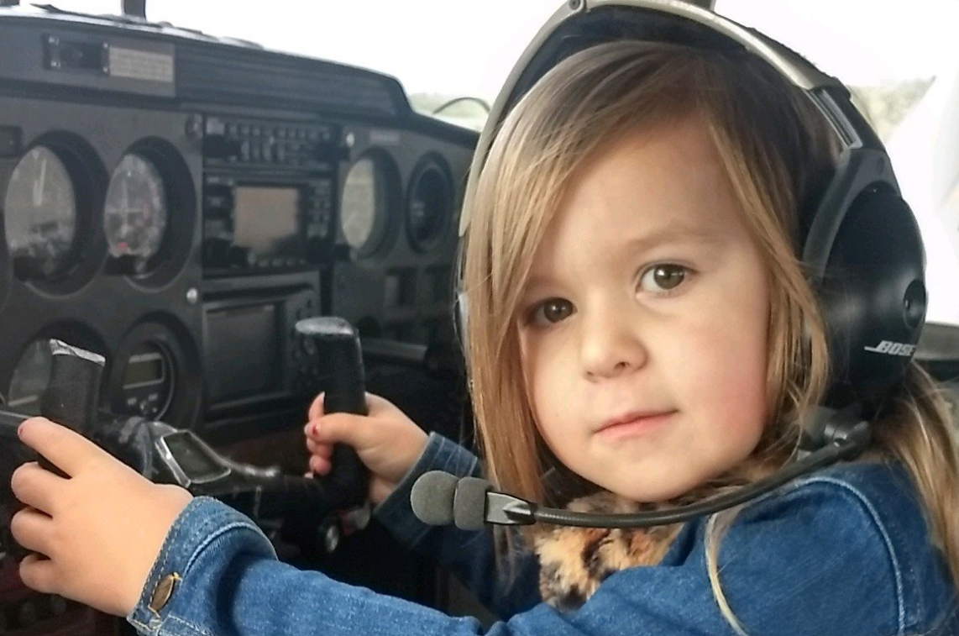
Ava at 10 and 4 years old

Slide 6
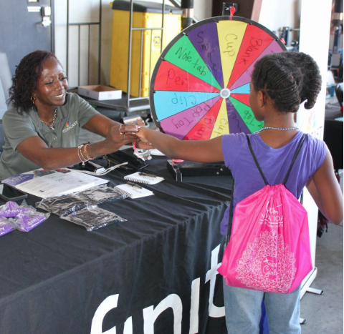
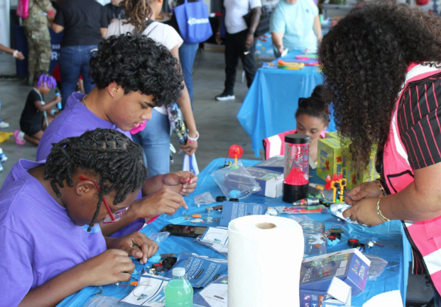
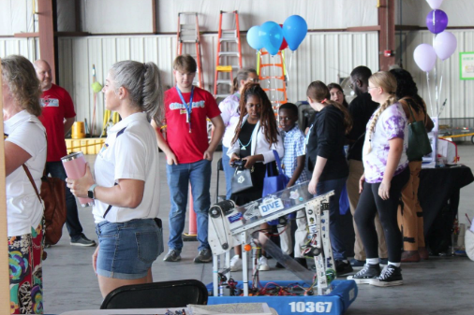
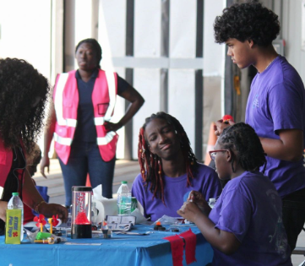
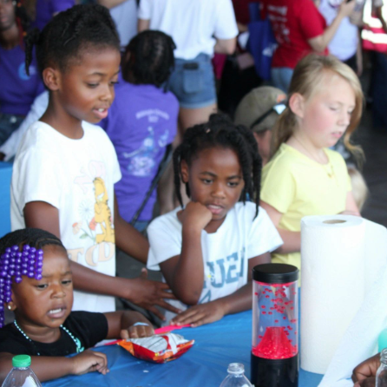
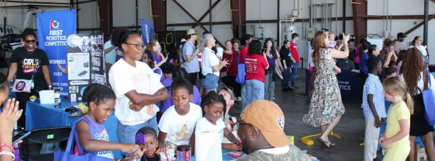

Slide 7
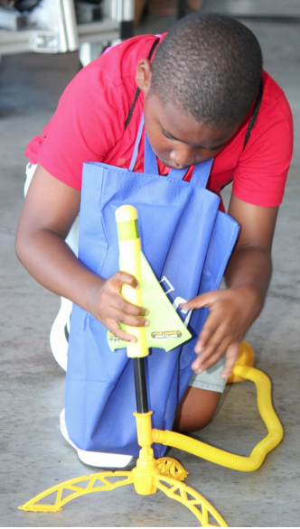
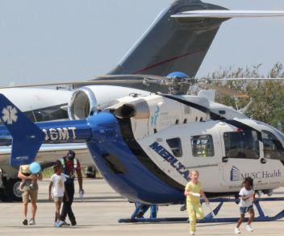
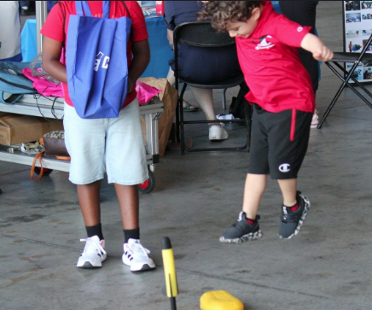
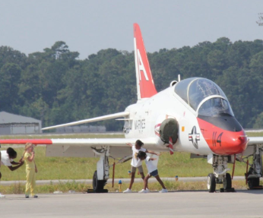
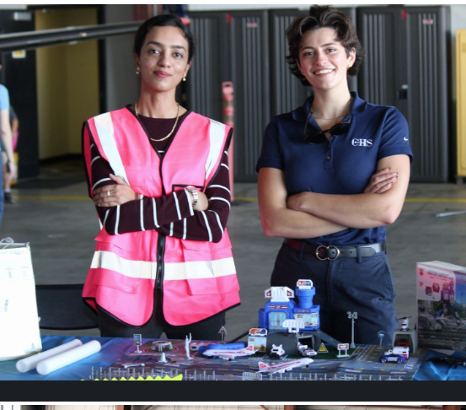

Slide 8

WAI: 2025 Meeting
Save the Date:
Thurs Oct. 2, 2025
4:00 – 6:00 pm
Location:
Signature Aviation Conference Room
5875 S Aviation Ave
N Charleston SC 29406
Open meeting /minute's/ introduction
GIAD 9/20 update data, post-event feedback, vendor updates, pictures “Thank you!” Thank you to our vendors.
Discuss board/open seats.
Review any changes to the Bylaws.
Planning the 2025 calendar – website, social media, building marketing strategy,
Share WAI website and Scholarship information –Deadline all entries and only 3 per person due by and no later than Oct. 10, 2025, by 11:50 EST. Answer and discuss Women in Aviation resources.
Plan and confirm date of WAI Christmas Party and Setup.
Closing
Light snacks will be served.
Attend Virtually Zoom meeting: 813 2793 3870 Passcode A1sfSG
Invite link https://us02web.zoom.us/j/81327933870?pwd=KSHHSEFW8x5aVtDqb93WSqtJjRxhPm.1 Host L L Participant ID 414955
Boeing employees please log time in YourCause and donate your time to the cause @WAI Women in Aviation Palmetto Pride Chapter Meeting
For more information: WAI President of SC: Leslie Lane 843-991-9396
WAI: Women in Aviation has so much to offer, come and join us.

